Slide 1
DRIVER DROWSINESS MONITORING SYSTEM USING VISUAL BEHAVIOUR
Under the Supervision of
Ms. Sk. Mulla Almas, MTech,
Asst. Professor, Dept. of IT
BY:
RAPOLU PAVAN KUMAR-18BQ1A12D2
THOTA CHARAN-18BQ1A12G0
SATTENAPALLI SRINIVASARAO – 18BQ1A12D9

Slide 2
Abstract
Drowsy driving is one of the major causes of road accidents and death. Hence, detection of driver’s fatigue and its indication is an active research area.
Most of the conventional methods are either vehicle-based, behavioral-based or physiological-based. Few methods are intrusive and distract the driver, some require expensive sensors and data handling.
Therefore, in this project, a low-cost, real-time driver’s drowsiness detection system has been developed by us with acceptable accuracy.

Slide 3
Abstract
In the developed system, a webcam records the video and the driver’s face is detected in each frame employing image processing techniques.
Facial landmarks on the detected face are pointed and subsequently the eye aspect ratio(EAR), mouth opening ratio(MOR) and nose length ratio(NLR) are computed and depending on their values, drowsiness is detected.

Slide 4
Insufficient sleep => Drowsy driving => Fatal Accidents
Solution: ‘Drowsy Driver Detection System’

Slide 5
Existing System
Driver drowsiness detection system detects weather the driver looks sleepy or not based on facial expressions.
If driver is blinking eyes in particular interval then we can conclude that driver is not in sleepy mode and active.
If driver is not at all blinking eyes then we can conclude that driver is drowsy and not active.
If Any drowsiness is detected then it just shows in the screen that the driver is drowsy.

Slide 6
Disadvantages
In existing system it just shows the driver that he is in sleepy. It will not alert the driver.
As no one is there to alert the driver there is more chance of an accident to take place.
Moreover some drivers may blink eyes more frequently and some may blink less frequently. But the existing system marks all of them as drowsy.
It has only single element to measure the drowsiness of the driver i.e., Blinking of eyes. So it’s not reliable completely.

Slide 7
Proposed System
The proposed system overcome the existing disadvantages by including more functionality to it.
In the proposed system it alerts the driver by playing an alarm sound to wake up the driver so that we can eradicate happening of accident.
Moreover we’ll send the location of the vehicle to the emergency contacts via SMS and WhatsApp message.
Here we’ll measure the drowsiness using eye aspect ratio(EAR), mouth opening ratio(MOR) and nose length ratio(NLR).

Slide 8
System Requirement Specification
Webcam based Implementation
Involves Feature extraction
Detect 68 landmarks points of the face
Region of Interest is Eyes and Mouth
Requirements Model
Requirements analysis, also called requirements engineering, is the process of determining user expectations for a new or modified product.
These features, called requirements, must be quantifiable, relevant and detailed. In software engineering, such requirements are often called functional specifications.

Slide 9
Requirements Model
Requirements analysis is critical to the success or failure of a systems or software project.
The requirements should be documented, actionable, measurable, testable, traceable, related to identified business needs or opportunities, and defined to a level of detail sufficient for System design.
User requirements
Execution time should be fast
More Accurate
User Friendly

Slide 10
Software requirements
O/S : Windows{7,8,10}, Linux
Language : Python3
Tools and Technologies : Visual Studio Code, Machine Learning
Hardware requirements
System : Intel i3 and above
Hard Disk : 256GB and above
Monitor : 15 VGA Colour
RAM : 4GB and above

Slide 11
Functional Requirements
System should be able to monitor the driver by capturing video and take the video as input.
Packages used are tkinter, scipy, imutils, numpy, dlib, cv2, argparse, play sound.
Each frame of video generates facial landmarks and different assessment metrics are calculated for each frame.
System should be able to identify the whether driver is drowsy or not correctly.
System should alert the driver when the driver is said to have drowsiness.

Slide 12
Non-Functional Requirements
Reliability:
The system is highly reliable.
Accessibility:
It can be easily accessible i.e., click & run.
Efficiency:
Resource consumption for given load is quite low.
Fault tolerance:
Our system is not fault tolerant due to insufficient hardware.
Robustness:
Our system is not capable to cope with errors during execution

Slide 13
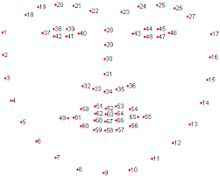
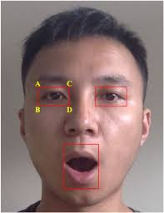
Implementation
Webcam based Implementation
Involves Feature extraction
Detect 68 landmarks points of the face
Region of Interest is Eyes and Mouth

Slide 14
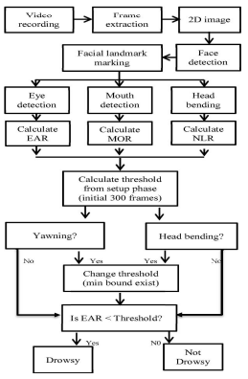
Architecture of the System

Slide 15
Thank You...

